Slide 1
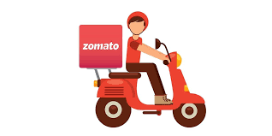
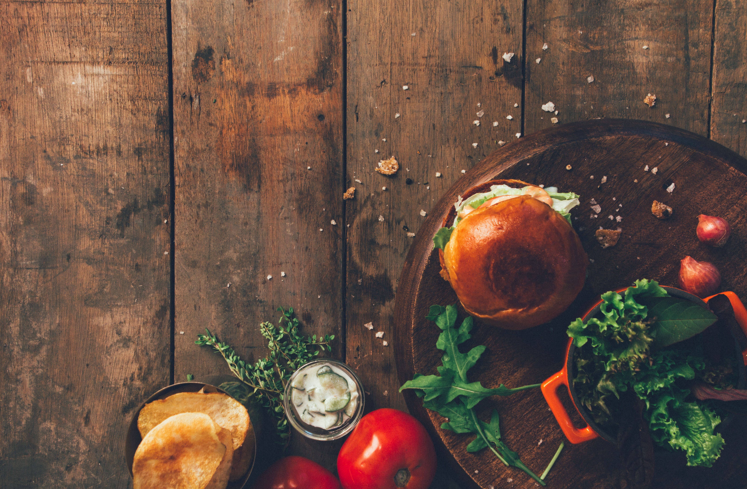


Zomato – Food Delivery Analysis

Slide 2



Web Scraping

Slide 3
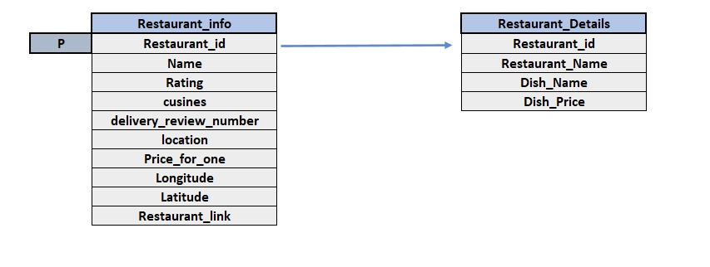
DATA OVERVIEW

Slide 4

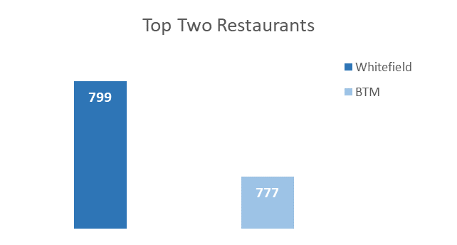
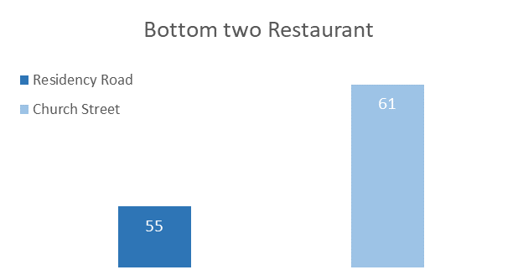
Area-wise distribution of restaurant
This data is of all the restaurants listed in Bangalore Zomato
As we can see from above charts Whitefield and BTM have highest number of restaurants and Residency Road and Church street have least number of restaurant listed with Zomato

Slide 5
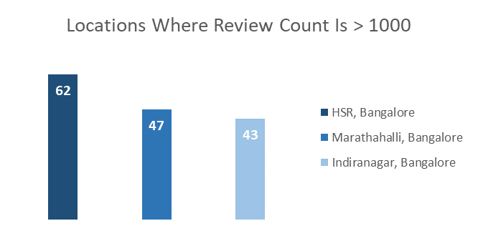
Location where delivery review number is greater than 1000
HSR, Marathahalli, Indranagar have highest number of delivery review numbers those are 62, 47 and 43 respectively in Zomato

Slide 6
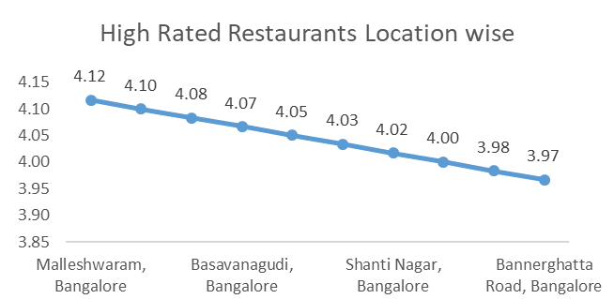
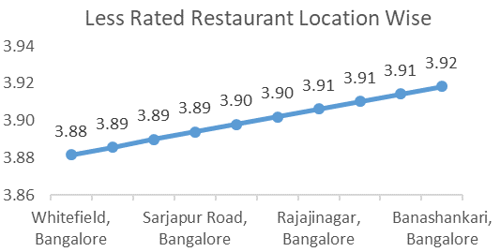
Area wise restaurant rating
Restaurants situated at Malleshwaram have highest number of ratings whereas Restaurants of Whitefield have least number of ratings in the city Bangalore

Slide 7
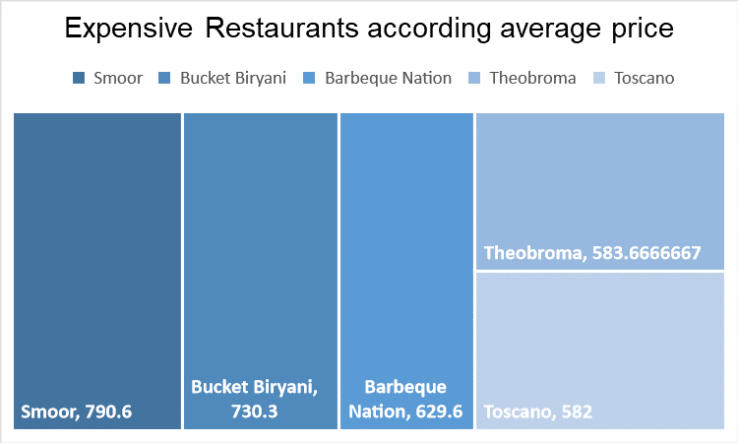
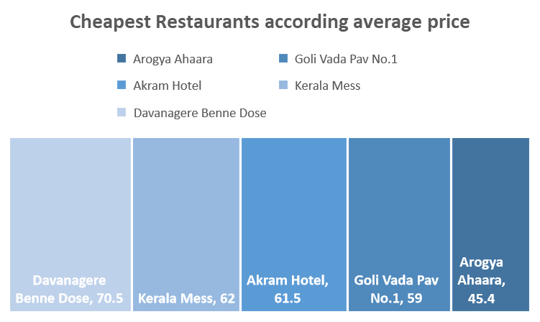
Cheap and expensive restaurant and their average price.
Smoor with average price 790 rupees is most expensive restaurant and Arogya Ahaara with 45 rupees is cheapest restaurant in Bangalore

Slide 8
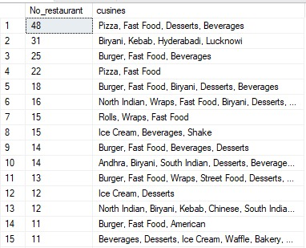
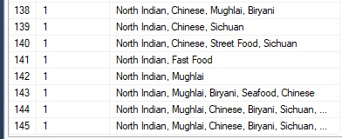
Number of restaurant for each type of cuisine.
Pizza, Fast food, Desserts and Beverages got highest number of restaurants among all categories for each type of cuisines which are 48.
Followed by Biryani, Kebab, Hyderabadi, Lucknowi which are 31
North Indian, Mughal, Chinese, biryani got least number of restaurants which is 1

Slide 9
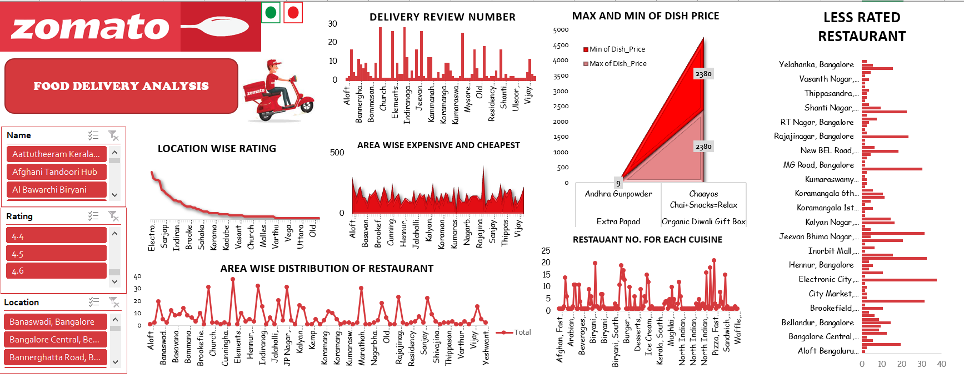
Dashboard

Slide 10
You are hired in a consultancy firm , one of their client want to open a remote kitchen (Only delivery) in Bangalore suggest them which location will be suitable for their restaurant and what should be the price of different types of dishes in early days.
Through above analysis we have figured out that Malleswaram and Basavanagudi got top rated restaurants as well as the number of restaurant in these areas are not so high, so competition is average, so we can say that person can open a kitchen in these areas
Average price for one in these areas is between 200-300 rupees, so our client should range price between 200-300 rupees
Most dishes consume by Bangalore public through Zomato are Pizza, Rolls, Biryani, Burgers, Sandwiches so our client should focus on selling these dishes

Slide 11






Part 2

Slide 12
Objectives:
Objectives:
We have to take input of Cuisine, Location, Price for one
Show Popular Cuisines, Most Popular restaurant etc based on the inputs
We had to recommend price and location based on ML model

Slide 13
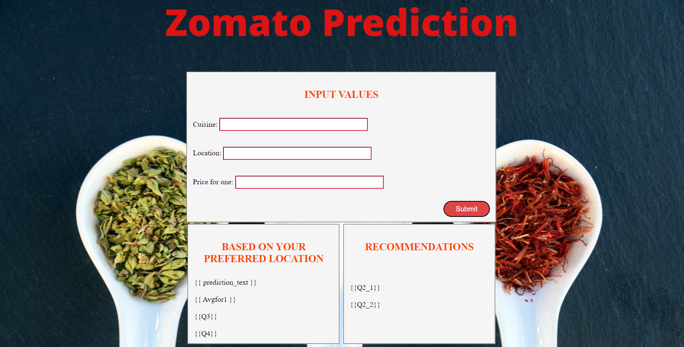
Webpage

Slide 14
Challenges Faced
We have to get the basic knowledge of HTML to scrap the data
Have learned python libraries like Selenium and BeautifulSoup through documentation, YouTube and articles of medium and stack overflow
HTML and CSS knowledge to create the webpage
We have to learn Flask to integrate the webpage with the help of Pickle library
Further cleaning of data was done with the help of pandas library of python and excel,as well as calculation for values

Slide 15
Learnings
We learned various libraries of python Selenium, BeautifulSoup, Flask, Pickle
Learnt how to automate the website
Learnt to create webpage using HTML and CSS and integrating our model with the help of flask
Also helped us gain some knowledge about HTML.
Data cleaning and Data analysis specific to project
Worked as a team and all the team members put equivalent effort to complete the project

Slide 16

Submitted By
Aditya Shrivastava
Akash Thakker
Mrinal Pandey
Vishal Tomer

